Slide 1
Recommender Systems
P Sai Deekshith (1BM18CS148) M K Gagan Roshan (1BM18CS049)
Ankit Kesar (1BM18CS150) Pramod D Y (1BM19CS405)

Slide 2
Recommendation Systems
A recommendation Systems filters the data using different algorithms and recommends the most relevant items to users. It first captures the past behavior of a customer and based on that, recommends products which the users might be likely to buy.
For example, if you’ve recently purchased a book on Machine Learning in Python and you’ve enjoyed reading it, it’s very likely that you’ll also enjoy reading a book on Data Visualization

Slide 3
Why are Recommender Systems Important?
Recommendation systems are becoming increasingly important in today’s extremely busy world. People are always short on time with the myriad tasks they need to accomplish in the limited 24 hours. Therefore, the recommendation systems are important as they help them make the right choices, without having to expend their cognitive resources.
Here, we try to recommend the movies using some techniques or algorithms and also try to compare them since there are lot of techniques available.

Slide 4

Applications
NETFLIX
AMAZON
FACEBOOK
TWITTER
and many more...

Slide 5
Dataset

Slide 6
MovieLens
The input for our project is basically a csv file which is obtained from Movie Lens 100k Data Set. The dataset used for our algorithms has fields like User Id, Movie Id, Rating, Timestamp.
This data set consists of:
* 100,000 ratings (1-5) from 943 users on 1682 movies.
* Each user has rated at least 20 movies.

Slide 7
Algorithms

Slide 8
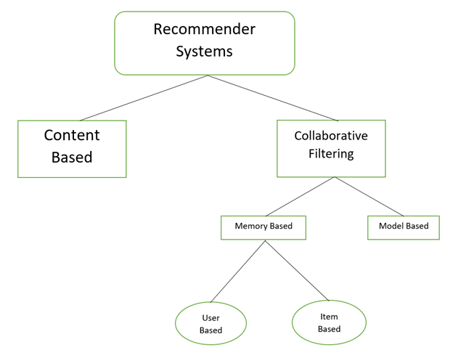
Hierarchy of Recommender System

Slide 9
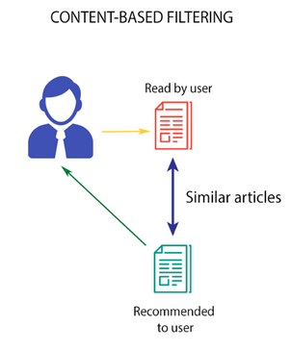
Content Based
This algorithm recommends product which are similar to the ones that user liked before
For example, if a person has liked the movie “Inception”, then this algorithm will recommend movies that fall under the same genre.

Slide 10
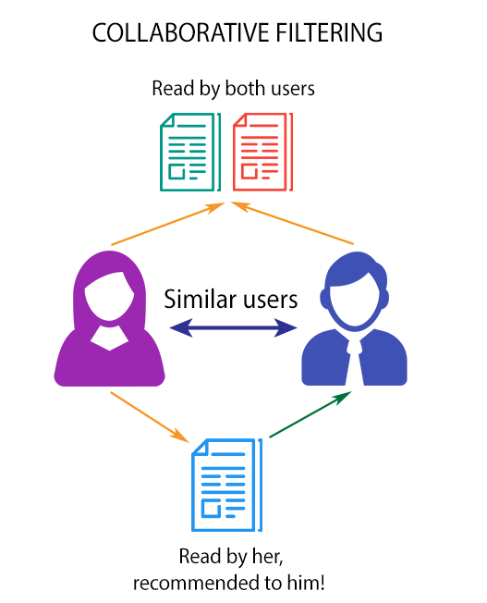
Collaborative Filtering
Collaborative filtering is based on the fact that relationships exist between products and people's interests. Many recommendation systems use collaborative filtering to find these relationships and to give an accurate recommendation of a product that the user might like or be interested in.

Slide 11
User Based Collaborative Filtering
User-Based Collaborative Filtering is a technique used to predict the items that a user might like on the basis of ratings given to that item by the other users who have similar taste with that of the target user.Many websites use collaborative for building their recommendation system. We are using Pearson correlation for recommending the movies.

Slide 12
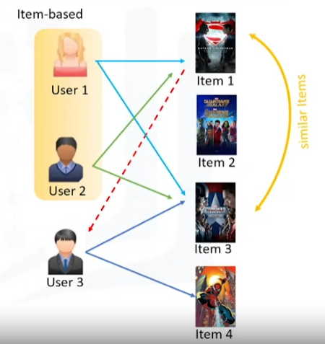
Item-to-Item Based Collaborative Filtering
It was first invented and used by Amazon in 1998. Rather than matching the user to similar customers, item-to-item collaborative filtering matches each of the user’s purchased and rated items to similar items, then combines those similar items into a recommendation list.

Slide 13
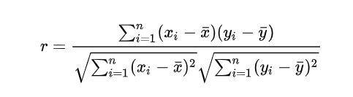
Pearson Correlation
Pearson correlation is invariant to scaling, i.e. multiplying all elements by a nonzero constant or adding any constant to all elements. For example, if you have two vectors X and Y,then, pearson(X, Y) == pearson(X, 2 * Y + 3). This is a pretty important property in recommendation systems because for example two users might rate two series of items totally different in terms of absolute rates, but they would be similar users (i.e. with similar ideas) with similar rates in various scale

Slide 14
Model-Based Recommendation Systems
Model-based algorithm tries to compress huge database into a model and performs recommendation task by applying reference mechanism into this model.
Instead of relying on pre-computed similarity (or distance) measures, model-based methods employ various prediction models to capture the latent relationship between users and items.
SVD
KNN

Slide 15
Results

Slide 16
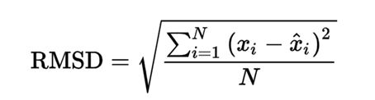
What is RMSE
Root Mean Square Error (RMSE) is a standard way to measure the error of a model in predicting quantitative data. Lower values of RMSE indicate better fit. RMSE is a good measure of how accurately the model predicts the response, and it is the most important criterion for fit if the main purpose of the model is prediction. Lower values of RMSE indicate better fit. RMSE is a good measure of how accurately the model predicts the response, and it is the most important criterion for fit if the main purpose of the model is prediction.

Slide 17
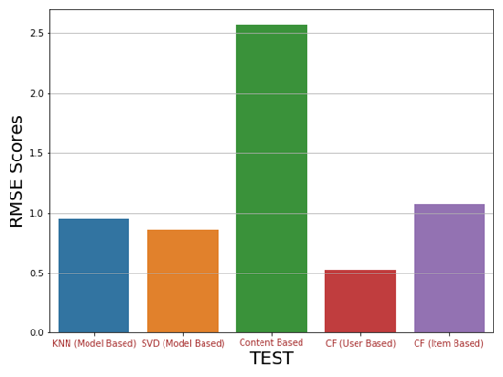
Bar Chart of RMSE Scores

Slide 18
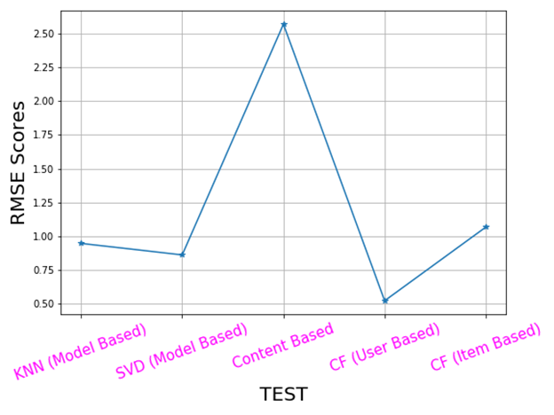
Line Chart of RMSE Values

Slide 19
Inferences
As expected, the Content Based Filtering gives us the least performance with a RMSE value of 2.5 approximately since doesn’t take into account what other user think of the movie, so low quality recommendations might happen.
All other algorithms gave a good score of RMSE value compare to content based recommender system.
Model Based using SVD and KNN also gave a good RMSE score ~ 1.
Collaborative Filtering (User Based) provided us with the best RMSE score which is around 0.42 which is least among all the other algorithms performed since it takes other user’s ratings also into consideration and it adapts to the user;s interests which might change over time.

Slide 20
Future Works

Slide 21
Future Works
Our future work includes improving the features of our implemented system. We have decided to extend our system to run against a list of book items and also recommending electronic items such as those present in e commerce sites like amazon.
Improving the advantages of our system is also the agenda of our future work. Our system is already better than some of the related recommender systems.
Further work includes implementing our algorithm such that it runs against real time and recommend items at a very faster rate than the related works of recommender systems.
Our Future works also include in making a hybrid recommender system which is a combination of content based and collaborative filtering technique

Slide 22
Conclusion

Slide 23
Conclusion
All in all, recommender systems can be a powerful tool for any Movie Recommendation, and rapid future developments in the field will increase their business value even further.
In this project we tried to recommend movies based on Movie Lens data set On successful evaluation of all our algorithms using RMSE we can concluded that Collaborative Filtering (User Based) is best algorithm for recommendation system.
The best RMSE score we could get for User Based algorithm is ~ 0.52.

Slide 24
Thank You

